Slide 1

Chapter 10 Planar Graphs
Section 10.3
Characterization of Planar Graphs

Slide 2
How to determine if a graph is planar
Having described features of planar graphs we need to address how to determine if a given graph is planar.
We will address two theorems used to determine if a graph is planar or not: Kuratowski’s and Wagner’s theorem.

Slide 3
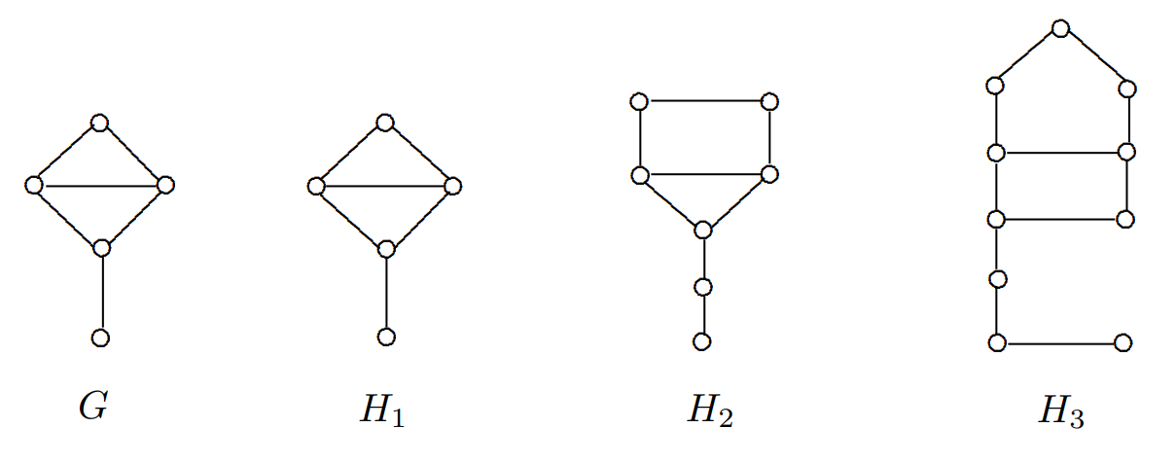

Kuratowski’s Theorem
A graph $H$ is a subdivision of a graph $G$ if either $H≅G$ or $H$ can be obtained from $G$ by inserting vertices of degree 2 into some, all or none of the edges of $G$.
Theorem 10.18 – Kuratowski’s Theorem
A graph $G$ is planar if and only if $G$ contains no subgraph that is a subdivision of $K_{5}$ or $K_{3,3}$

Slide 4
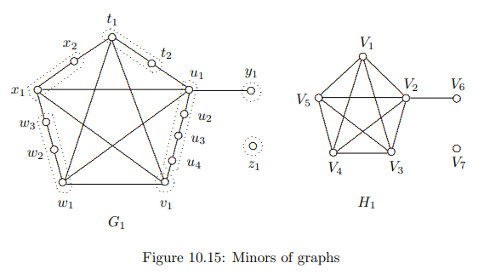
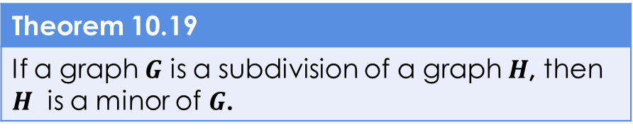

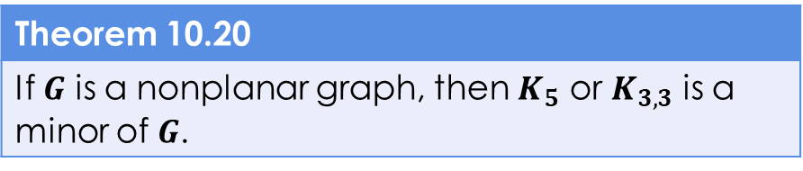
Minors of Graphs
A graph $H$ is called a minor of a graph $G$ if either $H≅G$ or a graph isomorphic to $H$ can be obtained from $G$ by a succession of edge contractions, edge deletions and vertex deletions (in any order).
If $H$ is a minor of $G$ such that $H≇G$ then $H$ is a proper minor of $G$.
Theorem 10.19
If a graph $G$ is a subdivision of a graph $H$, then $H$ is a minor of $G$.
Theorem 10.20
If $G$ is a nonplanar graph, then $K_{5}$ or $K_{3,3}$ is a minor of $G$.

Slide 5
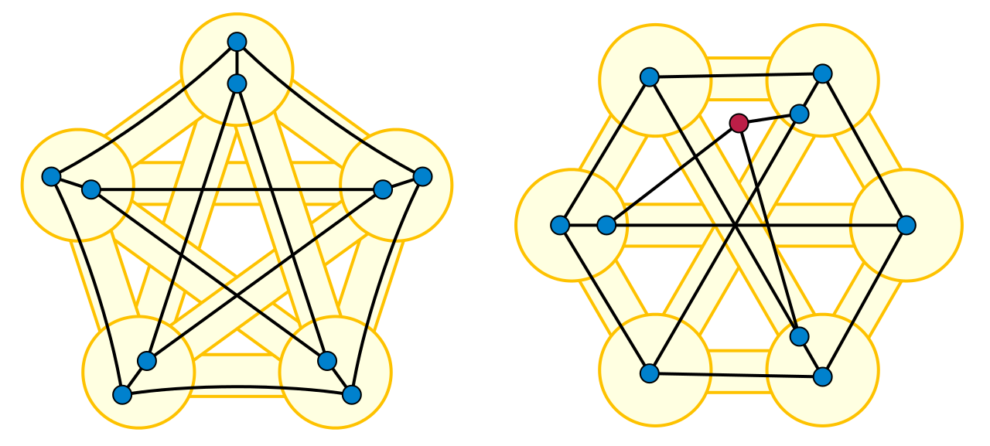
Wagner’s Theorem
Theorem 10.21 – Wagner’s Theorem
A graph $G$ is planar if and only if neither $K_{5}$ or $K_{3,3}$ is a minor of $G$.
https://upload.wikimedia.org/wikipedia/commons/thumb/8/87/Petersen_Wagner_minors.svg/1280px-Petersen_Wagner_minors.svg.png

Slide 6
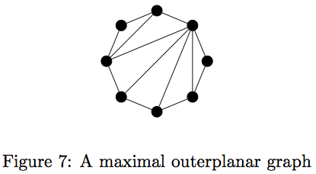

Outerplanar Graphs
A graph $G$ is outerplanar if there exists a planar embedding of $G$ so that every vertex of $G$ lies on the boundary of the exterior region.
https://petemcneely.files.wordpress.com/2013/03/maximal-outerplanar.png

Slide 7
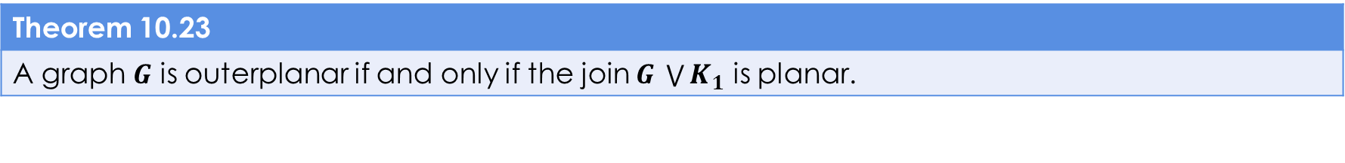
Outplanar Theorems
Theorem 10.23
A graph $G$ is outerplanar if and only if the join $G \bigvee{K_{1}}$ is planar.
Theorem 10.24
A graph $G$ is outerplanar if and only if $G$ contains no sub-graph that is a subdivision of $K_{4}$ or $K_{2,3}$.
Theorem 10.25
Every nontrivial outerplanar graph contains at least two vertices of degree 2 or less.
Theorem 10.26
The size of every outerplanar graph of order $n≥2$ is at most $2n−3$.

Slide 8

Theorems and Equations
Theorem 10.18 – Kuratowski’s Theorem
A graph $G$ is planar if and only if $G$ contains no subgraph that is a subdivision of $K_{5}$ or $K_{3,3}$
Theorem 10.19
If a graph $G$ is a subdivision of a graph $H$, then $H$ is a minor of $G$.
Theorem 10.20
If $G$ is a nonplanar graph, then $K_{5}$ or $K_{3,3}$ is a minor of $G$.
Theorem 10.21 – Wagner’s Theorem
A graph $G$ is planar if and only if neither $K_{5}$ or $K_{3,3}$ is a minor of $G$.
Theorem 10.23
A graph $G$ is outerplanar if and only if the join $G \bigvee{K_{1}}$ is planar.
Theorem 10.24
A graph $G$ is outerplanar if and only if $G$ contains no sub-graph that is a subdivision of $K_{4}$ or $K_{2,3}$.

Slide 9
Theorems and Equations (CONT.)
Theorem 10.4
If $G$ is a planar graph of order $n≥5$ and size $m$ such that $m>3n−6$, then $G$ is nonplanar
Theorem 10.25
Every nontrivial outerplanar graph contains at least two vertices of degree 2 or less.
Theorem 10.26
The size of every outerplanar graph of order $n≥2$ is at most $2n−3$.

